Slide 1
Accessing inventory data from SAP for Engineering/Marketing/Service operation created with Brity RPA designer/orchestrator
Terry Lee

Slide 2
Disclaimer
This file does not contain any sensitive corporate data, specific process details, or information pertaining to any particular organization or individuals. Its purpose is to offer a high-level view of the generic steps taken by the authors to address a specific business problem. It serves as a scalable and adaptable template, enabling the replication of these steps for solving similar problems in future. Additionally, it includes technical details that can be partially or entirely reused for ongoing learning and improvement in future projects.

Slide 3
Business problem: The daily extract of inventory data from SAP requires employees to enter configuration, wait for server to respond for each steps in the process. This extracted excel data then should be shared with the team in a shared folder (eg. SharePoint) for easy and quick access.
There are many employees using SAP for pulling and updating data for various functions and different departments. If SAP interaction for repetitive tasks are automated end to end, it will result in immediate time and cost saving for the entire business, and greater employee experience where focus can be shifted to more meaningful tasks.
Solution: All administrative tasks utilizing any system (such as salesforce, SAP or in-house company portal) should be the target for Robotic Process Automation with unattended mode on a dedicated machine(s) which constantly runs all kinds of different business tasks at desired time.

Slide 4
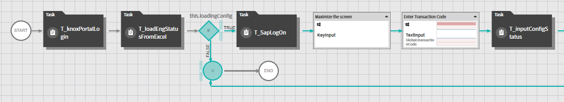
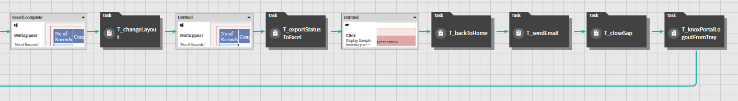
Process: extractSampleStatus
Task to view [1]

Slide 5
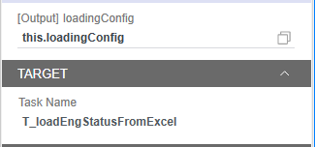
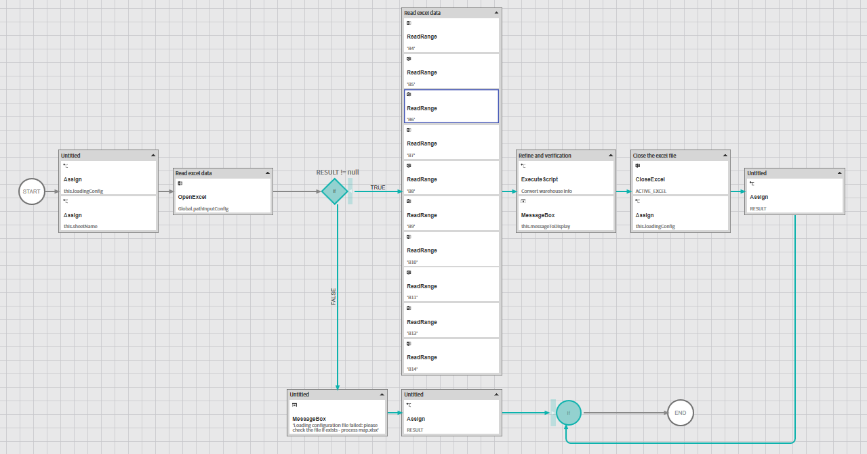
Task to view [1] – T_loadEngStatusFromExcel

